Slide 1

MBTA Speed Restriction Analysis
Joshua Soriano

Slide 2

Data
31 total columns, with 22,369 entries

Slide 3
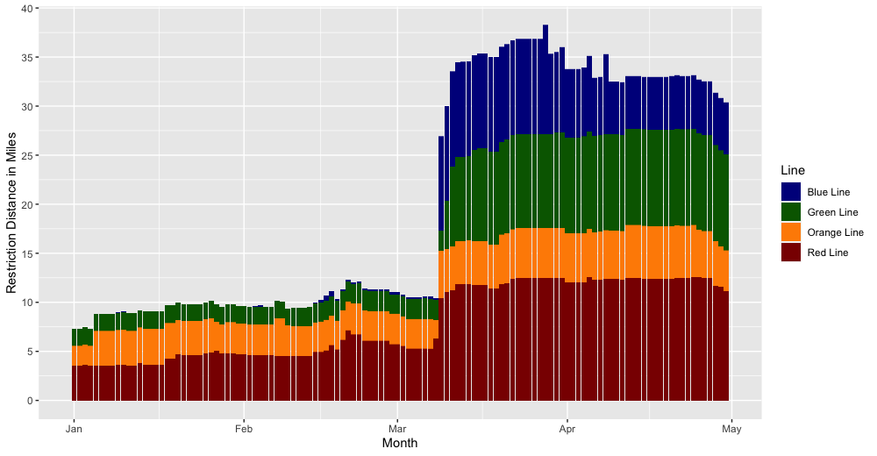
Restriction Distance Distribution

Slide 4
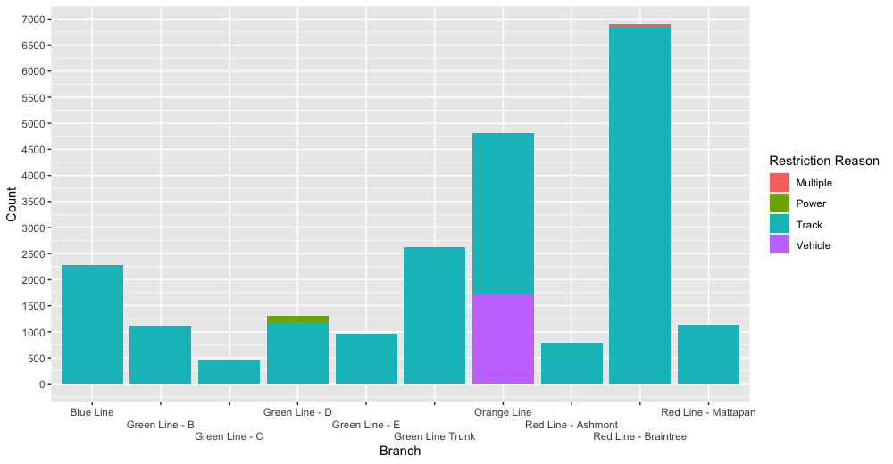
Restriction Reason For Each Branch

Slide 5
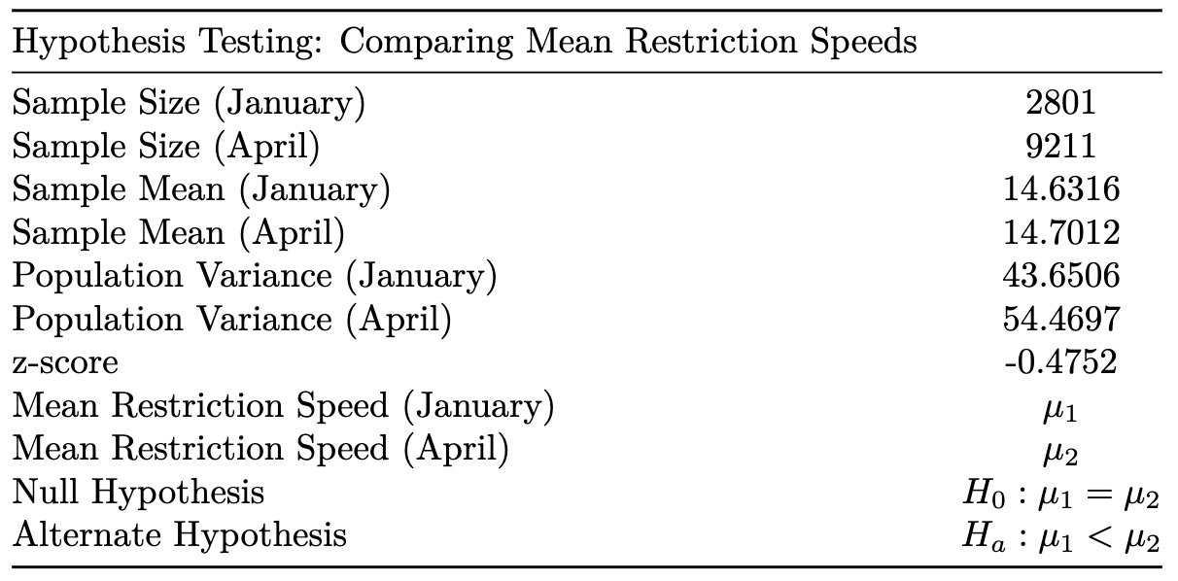
Result: p-value = 0.3173, fail to reject null hypothesis

Slide 6
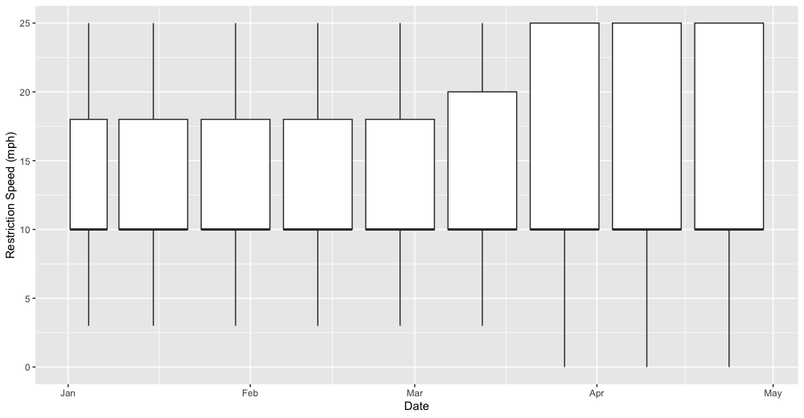
Restriction Speed Box Plot

Slide 7
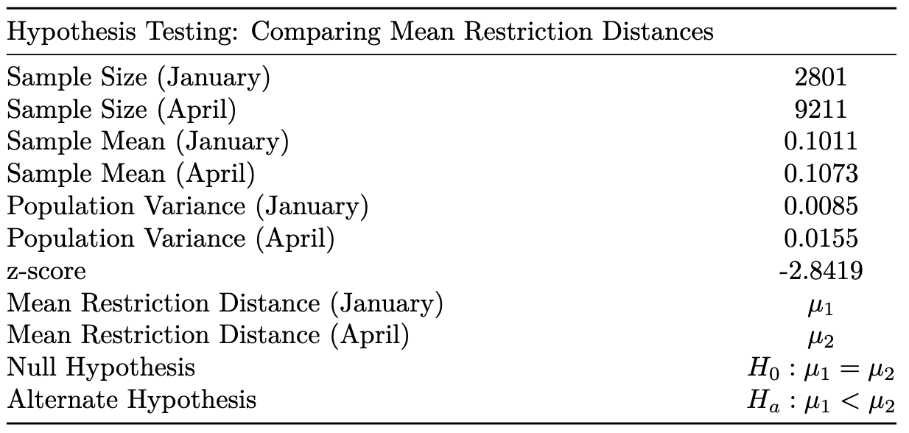
Result: p-value = 0.0022, reject null hypothesis

Slide 8
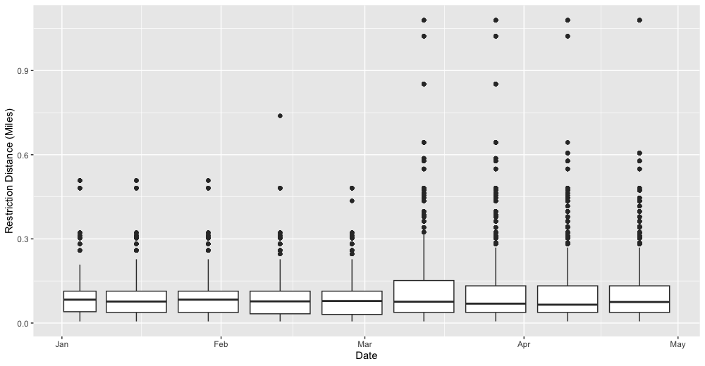
Restriction Distance Box Plot

Slide 9
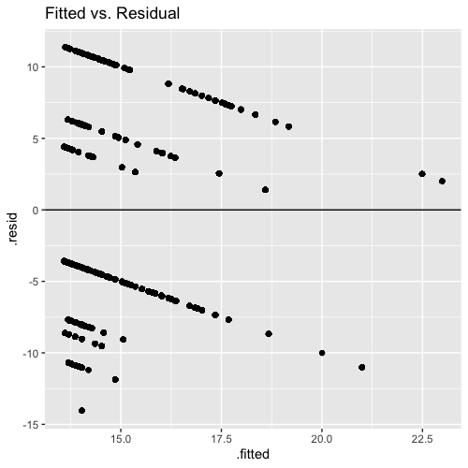
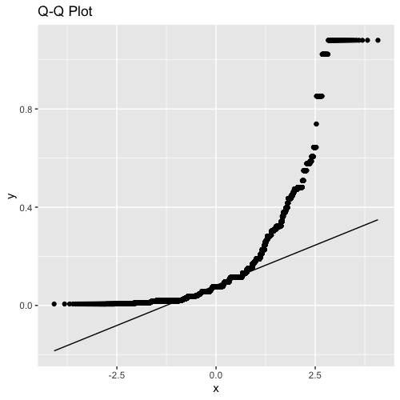
Linear Regression

Slide 10
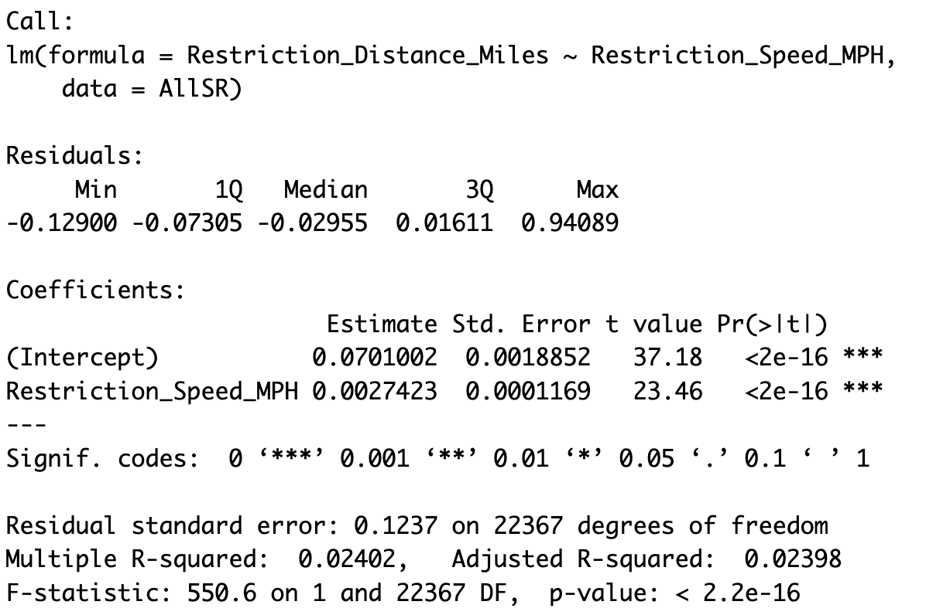
Regression Analysis

Slide 11
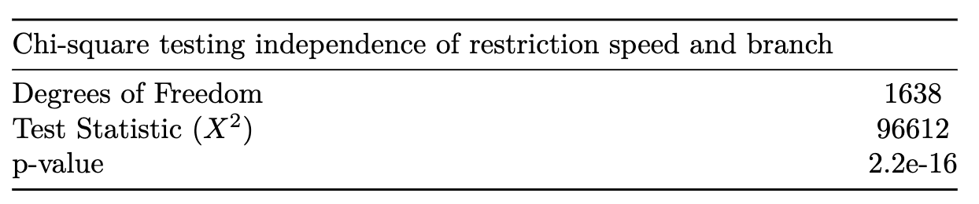
Chi-Square Test

Slide 12
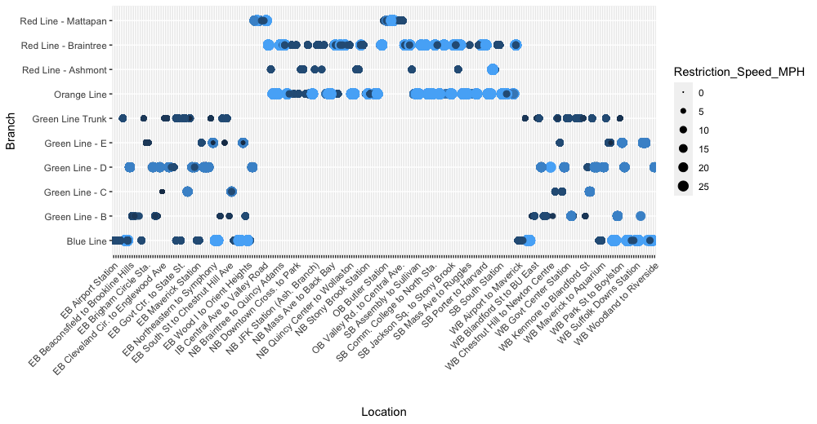
Restriction Speed Balloon Plot

Slide 13
Conclusion
The sudden influx of speed restrictions (especially the Blue Line) warrants investigation.
Track wear and tear requires further clarification, for a more accurate data analysis.
Detailed data compilation of speed restrictions for previous years is recommended for a more thorough analysis.
Variation in linear regression is largely unexplainable, and requires further investigation.
Chi-square test indicated restriction speed was not independent of location.

